Slide 1

BC3409: AI in accounting & finance
Improving national financial wellbeing through MLai
Seminar 3 Team 1
Chan Shi Hui Amanda (U1910759K)
Harvinder Singh Chahal (U1910668J)
Lee Wei Jie James (U1810181K)
Tan Jing Yu, Denis (U1810101D)
Valerie Chang (U1810071D)
Notes:
Good afternoon ministry of social and family development. We are from team 1 and my group consists of harvinder, james, denis, valerie and myself amanda. Today, we aim to help you improve national financial well-being through our analytics approach.

Slide 2

CONTENT OUTLINE
01
02
03
04
05
INTRODUCTION/ANALYTICS APPROACH
DATA PREPARATION and understanding
MODEL DEVELOPMENT AND EVALUATION
PROPOSED BUSINESS RECOMMENDATIONS
limitations/FUTURE WORK/CONCLUSION
Notes:
This will be the content outline for today. So i’ll be introducing to you the problem, Harvinder will be going through the data preparation and understanding, Denis will explain our model development and evaluation, Valerie will introduce our proposed business recommendations and lastly James will explain future work and conclusion

Slide 3

01
INTRODUCTION/analytics approach

Slide 4
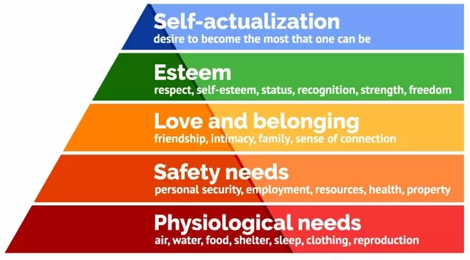
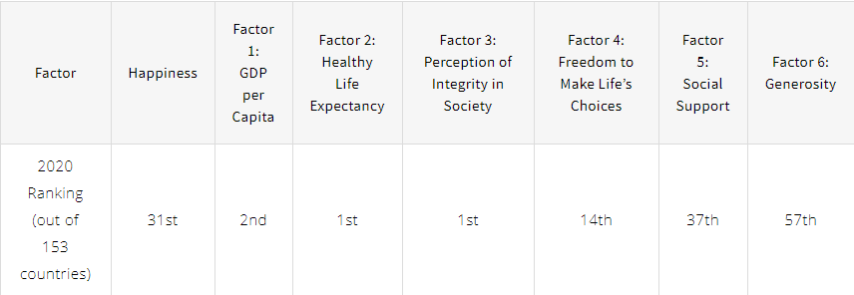
BACKGROUND
Singapore is only ranked 31st on the happiness index
Ranked only 14th in freedom to make life choices
Freedom to make life choices linked to financial well-being
Introduction/Analytics Approach | Data Preparation and Understanding | Model Development and Evaluation | Proposed Business Recommendations | Limitations/Future Work/Conclusion
Notes:
Singapore is known to have one of the world’s best education, booming economy, and high healthy life expectancy. However, despite these, we are only ranked 31st on the happiness index. The government has extended various sorts of financial aid to help people suffering from poverty meet their daily needs for food, shelter and education, and these factors form the basis of happiness according to Maslow’s hierarchy of needs. Despite government interventions, it seems that general happiness has not increased.
Out of the six factors that contributed to the Happiness Index score, Singapore ranked 1st in healthy life expectancy and perception of integrity in society and 2nd in gdp per capita. However, we are only ranked 14th in freedom to make life choices which definitely can be improved. The freedom to make life’s choices can be linked to a concept known as financial well-being and according to research, happiness is also impacted by financial well-being, beyond just income level and basic day-to-day living expenses. By improving a person’s financial well-being, they will be able to have greater freedom to make life choices, and hence increasing their happiness.
Therefore, it becomes critical that we are able to identify people who do not have this financial freedom and are hence unhappy, yet remain undetected by current measures for financial aid from the Singapore Government.

Slide 5
Significance of problem
Poor financial well-being has adverse impacts on one’s physical, mental and social health
Singapore rank on OCBC Financial Wellness Index dropped to 61
Poor financial well-being may lead to decreased happiness level
Seek to identify people with poor financial well-being to increase their happiness level
Introduction/Analytics Approach | Data Preparation and Understanding | Model Development and Evaluation | Proposed Business Recommendations | Limitations/Future Work/Conclusion
Notes:
Studies have shown that poor financial well-being can adversely impact one’s physical, mental and social health which can lead to other negative impacts such as poorer job performance, lower productivity and absenteeism, all of which could lead to unhappiness. The OCBC Financial Wellness Index, which is a measurement of Singapore’s financial wellness, has dropped from 63 in 2019 to 61 in 2020, especially due to COVID-19 pandemic. With the current pandemic, more people are likely to have poor financial well-being which may result in decreased happiness level.
Given that Singapore’s main resource is its population, the government aims to bridge the income gap to ensure that all Singaporeans are given equal opportunities. The improvement of financial well-being will not only improve these people’s happiness, but also their productivity and health.
Therefore, identifying these people with poor financial well-being will allow the government to more efficiently allocate resources such as money, time and effort, towards those who require financial aid the most to achieve greater happiness. Thus, we need a systematic approach to identify these people through machine learning and artificial intelligence techniques.

Slide 6
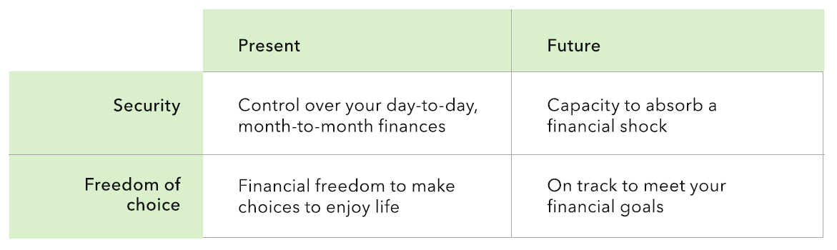
FINANCIAL WELL-BEING AND HAPPINESS
Financial well-being used as a proxy for happiness
Introduction/Analytics Approach | Data Preparation and Understanding | Model Development and Evaluation | Proposed Business Recommendations | Limitations/Future Work/Conclusion
Notes:
Overall happiness is a subjective measure that is affected by a myriad of factors, thus it would be unrealistic to tackle the whole nationwide population of unhappiness. This is why we have decided to use financial well-being as a proxy for happiness as this would mean that our target group of people’s level of happiness can be partially fulfilled by financial aid.

Slide 7




problem
Effectiveness
Reliability
Efficiency
Cost
Introduction/Analytics Approach | Data Preparation and Understanding | Model Development and Evaluation | Proposed Business Recommendations | Limitations/Future Work/Conclusion
Notes:
As we dive in deeper in identifying people who do not have financial freedom and are hence unhappy, there are the smaller problems in the current approach in terms of its effectiveness, reliability, efficiency and cost

Slide 8
eFFECTIVENESS
Singapore’s happiness index score is still so low despite government’s efforts
Introduction/Analytics Approach | Data Preparation and Understanding | Model Development and Evaluation | Proposed Business Recommendations | Limitations/Future Work/Conclusion
Notes:
Firstly, there is a lack of effectiveness in the current where Singapore’s happiness index score is still so low despite government’s efforts

Slide 9
reliability
Involve many paper work and human intervention
Increases the margin for errors and inconsistencies
Difficult to detect whether the documents have been tampered with by humans
Introduction/Analytics Approach | Data Preparation and Understanding | Model Development and Evaluation | Proposed Business Recommendations | Limitations/Future Work/Conclusion
Notes:
Next, the reliability in the current approach may be lacking as there are many paper work and human intervention which increases the margin for errors and inconsistencies. It is also hard to detect whether the documents have been tampered with throughout the communication process. As compared to our approach where we put all the data in the central database which makes it easier to check also

Slide 10
efficiency
Currently, MSF have to perform so many grants for every Singaporean and check their eligibility
Results in manpower and compliance loss
Introduction/Analytics Approach | Data Preparation and Understanding | Model Development and Evaluation | Proposed Business Recommendations | Limitations/Future Work/Conclusion
Notes:
Currently one of the problem is efficiency where MSF have to perform so many grants for each person and check their eligibility. This leads to manpower and compliance loss as alot of time are spent doing this.

Slide 11
cost
There are people who do not qualify for grants but yet MSF cannot help them
Introduction/Analytics Approach | Data Preparation and Understanding | Model Development and Evaluation | Proposed Business Recommendations | Limitations/Future Work/Conclusion
Notes:
Lastly, there is the problem in terms of cost such that MSF knows that there are people who do not qualify for grants but yet cannot help them due to the lack of extra funds.

Slide 12
ANALYTICS APPROACH
Government have access to citizens personal data (both financial and non-financial data)
In Singapore, citizens receive financial aid from various Ministries according to their per capita income and housing type
However, financial well-being is unable to be captured fully through financial measures
Thus this grey area needs a more sophisticated solution through a data-driven approach
Leverage on data analytics to sieve through the wide array of personal data that the government collects
Aggregate a better and more holistic judgement of a person’s financial well-being
Extend financial help to throes struggling to obtain financial well-being and happiness
Introduction/Analytics Approach | Data Preparation and Understanding | Model Development and Evaluation | Proposed Business Recommendations | Limitations/Future Work/Conclusion
Notes:
Today, government agencies have access to a great deal of personal data (both financial and non-financial data) of its citizens. In Singapore, citizens receive financial aid from various Ministries according to their per capita income as well as housing type. Yet, we know that financial well-being is unable to be captured fully through basic financial measures such as income or housing. This grey area requires a more sophisticated solution through a data-driven approach.
Using machine learning and artificial intelligence techniques, we aim to leverage on data analytics to sieve through the wide array of personal data that the government collects in order to aggregate a better and more holistic judgement of a person’s financial well-being and hence extend financial help to those struggling to obtain financial well-being and happiness. Now i will pass on the time to harvinder who will be going through our data preparation and understanding process.

Slide 13

02
DATA preparation and understanding

Slide 14

Dataset Description
Survey conducted by the Consumer Financial Protection Bureau (CFPB) in 2015 .
Consists of 217 columns and 6395 rows
The y-variable, “FWBscore” is a discrete integer that indicates a person’s financial well-being on a scale of 0-100
Introduction/Analytics Approach | Data Preparation and Understanding | Model Development and Evaluation | Proposed Business Recommendations | Limitations/Future Work/Conclusion
Notes:
Today, government agencies have access to a great deal of personal data (both financial and non-financial data) of its citizens, such as phone and traffic records, health records (including genetic records), spending habits, water and electricity consumption, and even online browsing activities.
In Singapore, citizens receive financial aid from various Ministries (MSF, MOM, MOE) according to their per capita income as well as housing type. Yet, we know that financial well-being is unable to be captured fully through basic financial measures such as income or housing. This grey area requires a more sophisticated solution through a data-driven approach.
Using machine learning and artificial intelligence techniques, we aim to leverage on data analytics to sieve through the wide array of personal data that the government collects in order to aggregate a better and more holistic judgement of a person’s financial well-being and hence extend financial help to those struggling to obtain financial well-being and happiness.

Slide 15

Dataset Description
The “FWBscore” scale was determined via extensive research and accurately measures a person’s financial well-being according to four key elements
Control over day-to-day finances
Capacity to absorb financial shock
Financial freedom to make choices to enjoy life
Being on track to meet financial goals.
The result was a 10 question scale-based scoring system that accorded each person in the dataset a holistic and comprehensive indicator of their financial well-being.
Additionally, indirect questions such as financial knowledge, education level, income and employment, family history, financial habits, demographic information were also asked in the survey.
Introduction/Analytics Approach | Data Preparation and Understanding | Model Development and Evaluation | Proposed Business Recommendations | Limitations/Future Work/Conclusion
Notes:
Today, government agencies have access to a great deal of personal data (both financial and non-financial data) of its citizens, such as phone and traffic records, health records (including genetic records), spending habits, water and electricity consumption, and even online browsing activities.
In Singapore, citizens receive financial aid from various Ministries (MSF, MOM, MOE) according to their per capita income as well as housing type. Yet, we know that financial well-being is unable to be captured fully through basic financial measures such as income or housing. This grey area requires a more sophisticated solution through a data-driven approach.
Using machine learning and artificial intelligence techniques, we aim to leverage on data analytics to sieve through the wide array of personal data that the government collects in order to aggregate a better and more holistic judgement of a person’s financial well-being and hence extend financial help to those struggling to obtain financial well-being and happiness.

Slide 16
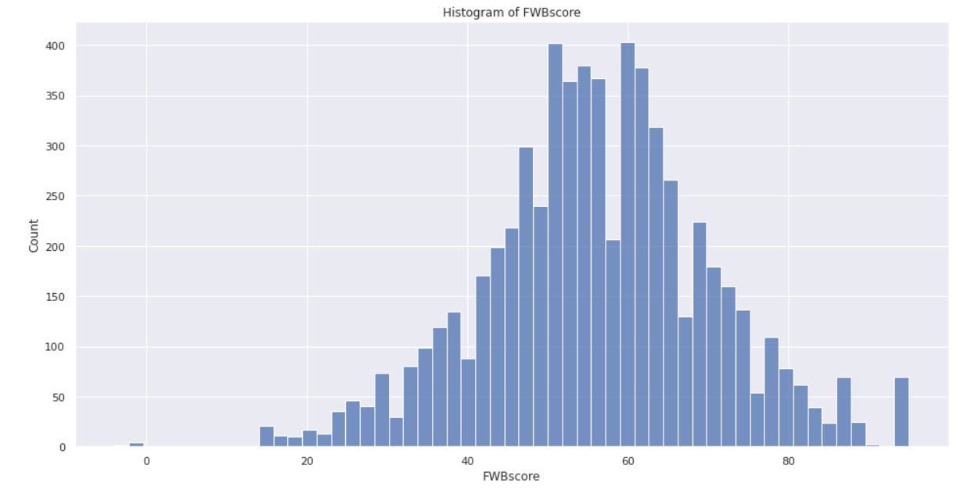
Data Exploration
The original distribution of FWBscore is roughly normally distributed with values ranging from 14-95, mean of 56 and standard deviation of 14.
“-4” indicates that the respondent’s answer was not written to the database.
“-1” indicates that the respondent refused to have the score calculated.
Introduction/Analytics Approach | Data Preparation and Understanding | Model Development and Evaluation | Proposed Business Recommendations | Limitations/Future Work/Conclusion
Notes:
Today, government agencies have access to a great deal of personal data (both financial and non-financial data) of its citizens, such as phone and traffic records, health records (including genetic records), spending habits, water and electricity consumption, and even online browsing activities.
In Singapore, citizens receive financial aid from various Ministries (MSF, MOM, MOE) according to their per capita income as well as housing type. Yet, we know that financial well-being is unable to be captured fully through basic financial measures such as income or housing. This grey area requires a more sophisticated solution through a data-driven approach.
Using machine learning and artificial intelligence techniques, we aim to leverage on data analytics to sieve through the wide array of personal data that the government collects in order to aggregate a better and more holistic judgement of a person’s financial well-being and hence extend financial help to those struggling to obtain financial well-being and happiness.

Slide 17
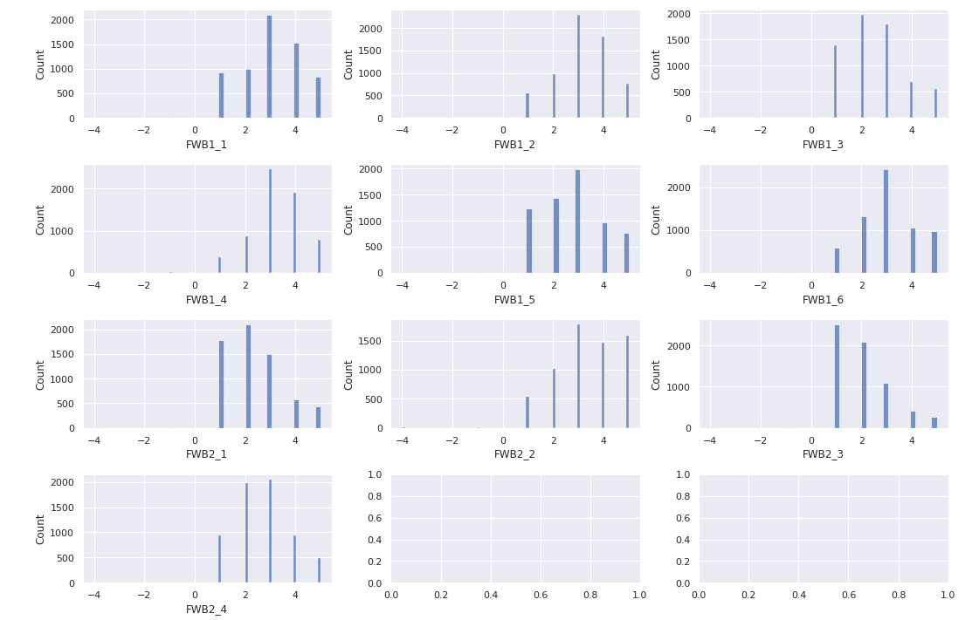
Data Exploration
Other features are roughly normally distributed with not much skew. The overall sentiment is that the respondents are quite optimistic about their own finances in terms of security and freedom of choice for present and future. However, the FWBscore's normal distribution would slightly disagree with the respondents' optimism
Introduction/Analytics Approach | Data Preparation and Understanding | Model Development and Evaluation | Proposed Business Recommendations | Limitations/Future Work/Conclusion
Notes:
Today, government agencies have access to a great deal of personal data (both financial and non-financial data) of its citizens, such as phone and traffic records, health records (including genetic records), spending habits, water and electricity consumption, and even online browsing activities.
In Singapore, citizens receive financial aid from various Ministries (MSF, MOM, MOE) according to their per capita income as well as housing type. Yet, we know that financial well-being is unable to be captured fully through basic financial measures such as income or housing. This grey area requires a more sophisticated solution through a data-driven approach.
Using machine learning and artificial intelligence techniques, we aim to leverage on data analytics to sieve through the wide array of personal data that the government collects in order to aggregate a better and more holistic judgement of a person’s financial well-being and hence extend financial help to those struggling to obtain financial well-being and happiness.

Slide 18

Data Preprocessing (data cleaning)
Summarizing, we removed 5 rows and 66 columns to produce a final dataset with 6389 rows and 151 columns
Pre-cleaned by CFPB
No missing values
No duplicates
Introduction/Analytics Approach | Data Preparation and Understanding | Model Development and Evaluation | Proposed Business Recommendations | Limitations/Future Work/Conclusion
Notes:
Today, government agencies have access to a great deal of personal data (both financial and non-financial data) of its citizens, such as phone and traffic records, health records (including genetic records), spending habits, water and electricity consumption, and even online browsing activities.
In Singapore, citizens receive financial aid from various Ministries (MSF, MOM, MOE) according to their per capita income as well as housing type. Yet, we know that financial well-being is unable to be captured fully through basic financial measures such as income or housing. This grey area requires a more sophisticated solution through a data-driven approach.
Using machine learning and artificial intelligence techniques, we aim to leverage on data analytics to sieve through the wide array of personal data that the government collects in order to aggregate a better and more holistic judgement of a person’s financial well-being and hence extend financial help to those struggling to obtain financial well-being and happiness.

Slide 19

Data Preprocessing (data cleaning)
All columns will be converted to categorical data type.
Except
The unique primary key “PUF_ID” will remain as integer data type.
The discrete score columns “FWBscore”, “FSscore”, “LMscore” will also remain as integer data types.
The float score columns “KHscore”, “finalwt” will remain as float data type.
Removal of rows with negative FWBscore
Introduction/Analytics Approach | Data Preparation and Understanding | Model Development and Evaluation | Proposed Business Recommendations | Limitations/Future Work/Conclusion
Notes:
Today, government agencies have access to a great deal of personal data (both financial and non-financial data) of its citizens, such as phone and traffic records, health records (including genetic records), spending habits, water and electricity consumption, and even online browsing activities.
In Singapore, citizens receive financial aid from various Ministries (MSF, MOM, MOE) according to their per capita income as well as housing type. Yet, we know that financial well-being is unable to be captured fully through basic financial measures such as income or housing. This grey area requires a more sophisticated solution through a data-driven approach.
Using machine learning and artificial intelligence techniques, we aim to leverage on data analytics to sieve through the wide array of personal data that the government collects in order to aggregate a better and more holistic judgement of a person’s financial well-being and hence extend financial help to those struggling to obtain financial well-being and happiness.

Slide 20

Data Preprocessing (Discretization)
Focus on those with severe financial issues
FWBscore (Bottom 20th percentile) At risk
FWBscore (Remaining population) Not at risk
Introduction/Analytics Approach | Data Preparation and Understanding | Model Development and Evaluation | Proposed Business Recommendations | Limitations/Future Work/Conclusion
Notes:
Today, government agencies have access to a great deal of personal data (both financial and non-financial data) of its citizens, such as phone and traffic records, health records (including genetic records), spending habits, water and electricity consumption, and even online browsing activities.
In Singapore, citizens receive financial aid from various Ministries (MSF, MOM, MOE) according to their per capita income as well as housing type. Yet, we know that financial well-being is unable to be captured fully through basic financial measures such as income or housing. This grey area requires a more sophisticated solution through a data-driven approach.
Using machine learning and artificial intelligence techniques, we aim to leverage on data analytics to sieve through the wide array of personal data that the government collects in order to aggregate a better and more holistic judgement of a person’s financial well-being and hence extend financial help to those struggling to obtain financial well-being and happiness.

Slide 21
Data Preprocessing (Feature selection)
Avoid curse of dimensionality Improve performance
Remove non informational columns Reduce run time
Introduction/Analytics Approach | Data Preparation and Understanding | Model Development and Evaluation | Proposed Business Recommendations | Limitations/Future Work/Conclusion
Notes:
Today, government agencies have access to a great deal of personal data (both financial and non-financial data) of its citizens, such as phone and traffic records, health records (including genetic records), spending habits, water and electricity consumption, and even online browsing activities.
In Singapore, citizens receive financial aid from various Ministries (MSF, MOM, MOE) according to their per capita income as well as housing type. Yet, we know that financial well-being is unable to be captured fully through basic financial measures such as income or housing. This grey area requires a more sophisticated solution through a data-driven approach.
Using machine learning and artificial intelligence techniques, we aim to leverage on data analytics to sieve through the wide array of personal data that the government collects in order to aggregate a better and more holistic judgement of a person’s financial well-being and hence extend financial help to those struggling to obtain financial well-being and happiness.

Slide 22
Data Preprocessing (Feature selection)
Removed Columns
Primary Key | Demographic & Poverty Differences | Direct Survey Questions for FWBscore | Secondary Survey Score | Items with Incomplete Base | Sensitive, Vague or Region Specific Questions | Specific Financial Knowledge Questions
PUF_ID | sample fpl | 10 Questions | FSscore LMscore KHscore finalwt | Multiple | Multiple | 12 Questions
Introduction/Analytics Approach | Data Preparation and Understanding | Model Development and Evaluation | Proposed Business Recommendations | Limitations/Future Work/Conclusion
Notes:
Today, government agencies have access to a great deal of personal data (both financial and non-financial data) of its citizens, such as phone and traffic records, health records (including genetic records), spending habits, water and electricity consumption, and even online browsing activities.
In Singapore, citizens receive financial aid from various Ministries (MSF, MOM, MOE) according to their per capita income as well as housing type. Yet, we know that financial well-being is unable to be captured fully through basic financial measures such as income or housing. This grey area requires a more sophisticated solution through a data-driven approach.
Using machine learning and artificial intelligence techniques, we aim to leverage on data analytics to sieve through the wide array of personal data that the government collects in order to aggregate a better and more holistic judgement of a person’s financial well-being and hence extend financial help to those struggling to obtain financial well-being and happiness.

Slide 23
Data Preprocessing (Data transformation)
Needs to be recognized by Machine Learning Models
Cast categorical columns into numbers
Use of binary encoding to achieve this
Introduction/Analytics Approach | Data Preparation and Understanding | Model Development and Evaluation | Proposed Business Recommendations | Limitations/Future Work/Conclusion
Notes:
Today, government agencies have access to a great deal of personal data (both financial and non-financial data) of its citizens, such as phone and traffic records, health records (including genetic records), spending habits, water and electricity consumption, and even online browsing activities.
In Singapore, citizens receive financial aid from various Ministries (MSF, MOM, MOE) according to their per capita income as well as housing type. Yet, we know that financial well-being is unable to be captured fully through basic financial measures such as income or housing. This grey area requires a more sophisticated solution through a data-driven approach.
Using machine learning and artificial intelligence techniques, we aim to leverage on data analytics to sieve through the wide array of personal data that the government collects in order to aggregate a better and more holistic judgement of a person’s financial well-being and hence extend financial help to those struggling to obtain financial well-being and happiness.

Slide 24
Data Preprocessing (Data Partitioning)
70% DATA Train-Set
30% DATA Test-Set
Introduction/Analytics Approach | Data Preparation and Understanding | Model Development and Evaluation | Proposed Business Recommendations | Limitations/Future Work/Conclusion
Notes:
Today, government agencies have access to a great deal of personal data (both financial and non-financial data) of its citizens, such as phone and traffic records, health records (including genetic records), spending habits, water and electricity consumption, and even online browsing activities.
In Singapore, citizens receive financial aid from various Ministries (MSF, MOM, MOE) according to their per capita income as well as housing type. Yet, we know that financial well-being is unable to be captured fully through basic financial measures such as income or housing. This grey area requires a more sophisticated solution through a data-driven approach.
Using machine learning and artificial intelligence techniques, we aim to leverage on data analytics to sieve through the wide array of personal data that the government collects in order to aggregate a better and more holistic judgement of a person’s financial well-being and hence extend financial help to those struggling to obtain financial well-being and happiness.

Slide 25

03
Model development and evaluation

Slide 26
Choice of machine learning algorithms
Type of Algorithms |  | Chosen Algorithms
Generalized Linear Model |  | 1) Logistic Regression
Tree-based | Single model | 2) Decision Tree Classifier
 | Ensemble | 3) Random Forest Classifier
 |  | 4) XGBoost Classifier
Kernel-based |  | 5) Support Vector Classifier
Naive Bayes |  | 6) Bernoulli Naive Bayes Classifier
Neural Network-based |  | 7) Artificial Neural Network
Introduction/Analytics Approach | Data Preparation and Understanding | Model Development and Evaluation | Proposed Business Recommendations | Limitations/Future Work/Conclusion

Slide 27
Hyperparameter tuning
Algorithms |  | Tuning Method | Specifications
Logistic Regression |  | Grid Search | Cross-validation trials = 3
Support Vector Classifier
Bernoulli Naive Bayes Classifier
Decision Tree Classifier |  | Random Search | Cross-validation trials = 3 Number of iterations = 100
Random Forest Classifier
XGBoost Classifier
Artificial Neural Network
Introduction/Analytics Approach | Data Preparation and Understanding | Model Development and Evaluation | Proposed Business Recommendations | Limitations/Future Work/Conclusion

Slide 28
Hyperparameters Tuned
Logistic Regression | Decision Tree Classifier | Random Forest Classifier | XGBoost Classifier | Support Vector Classifier | Bernoulli Naive Bayes Classifier | Artificial Neural Network
C class_weight | criterion max_depth min_samples_split min_samples_leaf max_features min_impurity_decrease class_weight | n_estimators criterion max_depth min_samples_split min_samples_leaf max_features min_impurity_decrease class_weight | max_depth learning_rate n_estimators booster gamma min_child_weight subsample colsample_bytree colsample_bylevel colsample_bynode reg_alpha reg_lambda scale_pos_weight | C kernel gamma class_weight | alpha | epochs dense_nparams init batch_size dropout
2 | 7 | 8 | 13 | 4 | 1 | 5
Introduction/Analytics Approach | Data Preparation and Understanding | Model Development and Evaluation | Proposed Business Recommendations | Limitations/Future Work/Conclusion

Slide 29
Confusion matrix explanation and its tradeoffs
True Positives | “At risk” candidates are successfully detected and further financial intervention can be planned for them
True Negatives | “Not at risk” candidates are successfully detected and no further action is needed
False Positives | “Not at risk candidates” are falsely identified as “At risk” and they take up resources that could be provided to those “At risk” candidates who truly need help
False Negatives | “At risk” candidates are falsely identified as “Not at risk” and early financial intervention cannot be provided to them
True Label | Not at risk (0) | True Negatives (TN) | False Positives (FP)
 | At risk (1) | False Negatives (FN) | True Positives (TP)
 |  | Not at risk (0) | At risk (1)
 |  | Predicted Label
Introduction/Analytics Approach | Data Preparation and Understanding | Model Development and Evaluation | Proposed Business Recommendations | Limitations/Future Work/Conclusion

Slide 30
CHOICE OF EVALUATION METRICS
Accuracy | Used when the true positives and true negatives are more important and the class distribution is balanced
Precision | Suitable evaluation metric when the costs of false positives are high
Recall | Suitable evaluation metric when the costs of false negatives are high
F1-Score | Suitable evaluation metric when the costs of false positives and false negatives are both high
Given that the data set is imbalanced with an 80% negative class and both false positives and false negatives are relatively important, our team will use F1-Score as the evaluation metric for choosing the final machine learning model. However, all 4 evaluation metrics will be calculated to examine the tradeoffs between different machine learning models.
Introduction/Analytics Approach | Data Preparation and Understanding | Model Development and Evaluation | Proposed Business Recommendations | Limitations/Future Work/Conclusion

Slide 31
Baseline f1-score
Purpose: A baseline F1-Score acts as a lower bound to evaluate the performances of the machine learning models. The baseline model will be defined as the dummy predictor where it will predict the candidate to be “At risk” or 1 all the time.
Precision TP / (TP + FP) | TP | 0.2 | 0.2 / (0.2 + 0.8) = 0.2 / 1 = 0.2
 | FP | 0.8
Recall TP / (TP + FN) | TP | 0.2 | 0.2 / (0.2 + 0) = 0.2 / 0.2 = 1
 | FN | 0
Baseline F1-score = 2 * (precision * recall) / (precision + recall) Since precision = 0.2 and recall = 1, Baseline F1-score = 2 * (0.2 * 1) / (0.2 + 1) Baseline F1-score = 0.4 / 1.2 = 0.3333
Introduction/Analytics Approach | Data Preparation and Understanding | Model Development and Evaluation | Proposed Business Recommendations | Limitations/Future Work/Conclusion

Slide 32
Comparison of evaluation metrics
 | Accuracy | Precision | Recall | F1-Score
Logistic Regression | 0.8821 | 0.7477 | 0.6279 | 0.6826
Decision Tree Classifier | 0.8086 | 0.5158 | 0.8424 | 0.6398
Random Forest Classifier | 0.8472 | 0.5816 | 0.8656 | 0.6957
XGBoost Classifier | 0.8811 | 0.6916 | 0.7416 | 0.7157
Support Vector Classifier | 0.8649 | 0.6194 | 0.8579 | 0.7194
Bernoulli Naive Bayes Classifier | 0.8279 | 0.5494 | 0.8191 | 0.6577
Neural Network | 0.8816 | 0.7778 | 0.5788 | 0.6637
Final model chosen based on F1-Score criteria
Introduction/Analytics Approach | Data Preparation and Understanding | Model Development and Evaluation | Proposed Business Recommendations | Limitations/Future Work/Conclusion

Slide 33

04
Proposed business recommendations

Slide 34

Recommendation 1: Application of the Proof of Concept to Actual Dataset and Identify Target Group to Assist
Implementation
objective
1
Help policymakers identify the target group of people that are “At risk” of low financial well-being leading to unhappiness
2
Can tailor financial and non-financial aid to their needs
Input variables can be changed to better suit the local context and include any available information that the SingPass database may already contain
Adaptation from poc
MediSave coverage
Ethno-cultural details
BTO status
Introduction/Analytics Approach | Data Preparation and Understanding | Model Development and Evaluation | Proposed Business Recommendations | Limitations/Future Work/Conclusion
Notes:
Thanks Denis. Our main recommendation would be to apply the POC to the actual dataset. This would 1. Help policymakers identify the target group of people that are “At risk” of low financial well-being leading to unhappiness so that 2. The govt can tailor financial and non-financial aid to their needs. To adapt it from the POC, The input variables can be changed to better suit the local context to include info available in Singpass or other govt databases.

Slide 35







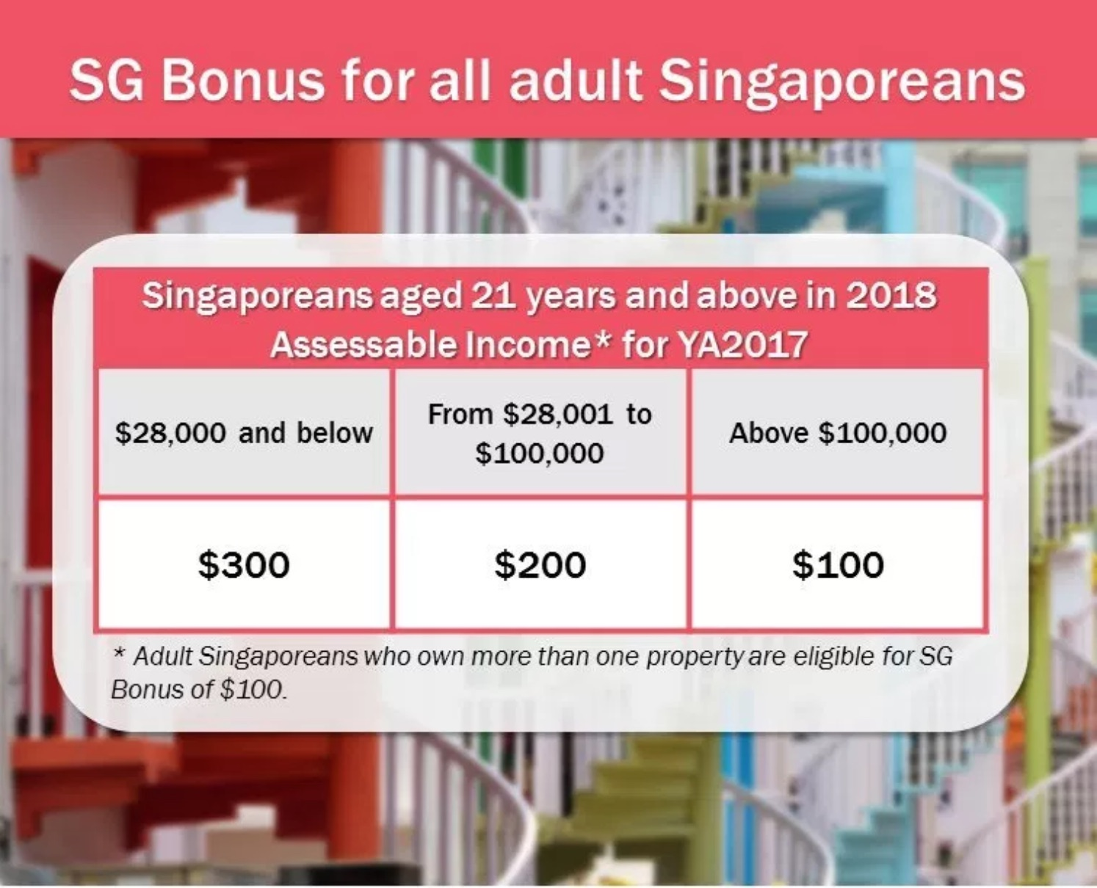
Policy Level Implementation
Implement new policies
Budget Reallocation
Private-public sector collaboration
Adjusting existing comcare budget
inefficient budget spend from other ministries
Eg SG Bonus
Those who still require finances for basic needs
Channel budget surplus towards those who will benefit more from monetary rewards
Introduction/Analytics Approach | Data Preparation and Understanding | Model Development and Evaluation | Proposed Business Recommendations | Limitations/Future Work/Conclusion
Notes:
After identifying the target group these are some recommendations for what the govt can do with the findings. First is policywise. Our findings can impact policy decisions on many fronts and across different ministries. But we think that the greatest benefit can be brought about through budget reallocation in a strategic manner towards this target group. We want to be able to improve their financial well-being and happiness without compromising the welfare of others who still require finances for basic needs. So we don’t want to adjust the existing comcare budget but optimize inefficient spending in other ministries.
One of the current measures the Singapore Government has introduced is the SG bonus. This occurs when the Government has a budget surplus for the fiscal year and decides to issue a one-time bonus to all Singaporean adults above 21.
But, not everyone may elicit the same response to this measure. Someone who makes $100,000 a year may not appreciate that extra $100 as much as someone who makes $20,000 a year.
As such, the Singapore Government could channel the funds towards the target “At Risk” group whose happiness can be impacted by more financial measures. This will allow them to give out these bonuses to those who require it more rather than giving it out to everyone.

Slide 36



Ministry and Individual Level Implementation
MSF can can assign dedicated financial planners to help these people plan their finances properly
proper financial planning is required so that these people will be able to eventually achieve the financial freedom required to make their own life choices
1.
2.
3.
Expert financial planners
Solve their specific financial issues
Long term financial planning
Mandatory pro-bono work for financial institutions
Introduction/Analytics Approach | Data Preparation and Understanding | Model Development and Evaluation | Proposed Business Recommendations | Limitations/Future Work/Conclusion
Notes:
On a ministry level, the MSF can assign dedicated financial planners to help these people plan their finances properly so that these people will be able to eventually achieve the financial freedom required to make their own life choices. Having a group of financial planners specialized in helping these “At risk” individuals will help them solve their specific financial issues, and better aid them in the long term. These volunteers can be sought from various financial institutions as a form of pro-bono work.

Slide 37



Subgroup Level Implementation
People who are identified with a low FWB score are bound to show similar traits
$
Poor Financial knowledge
Mental psyche
Poor outlook on life
Inability to pay bills on time
Focused solutions
Raise fwb score
Greater freedom to make life choices
Increased happiness
Introduction/Analytics Approach | Data Preparation and Understanding | Model Development and Evaluation | Proposed Business Recommendations | Limitations/Future Work/Conclusion
Notes:
Lastly we can make use of the data to reveal subgroups. People who are identified with a low FWB score are bound to show similar traits. As such, focused solutions need to be tailored to bridge the gap between this “At risk” group and the general population. This will raise their FWB score, suggesting greater freedom to make life choices and hence increase the happiness index of Singapore.

Slide 38
Subgroup Level Implementation
People who are identified with a low FWB score are bound to show similar traits
$
Poor Financial knowledge
Mental psyche
Poor outlook on life
Inability to pay bills on time
Classes on financial terms, investment strategies, saving habits, and various bank schemes
Scheduled appointments with therapists, providing an avenue to talk about their problems and develop a better mindset
Alternative billing methods, taking a loan, or extending the deadline for payment
Introduction/Analytics Approach | Data Preparation and Understanding | Model Development and Evaluation | Proposed Business Recommendations | Limitations/Future Work/Conclusion
Notes:
In the case of individuals with poor financial knowledge, a recommendation would be to provide classes on financials.
As both pessimism and a poor outlook on life are aspects of mental health, the government should schedule appointments with therapists because they would unlikely schedule it if left to their own devices.
Lastly, individuals who are unable to pay their utility bills can be offered alternative options such as alternative billing methods.

Slide 39
Recommendation 2: Design of Graphical User Interface
Users of this solution (officers of MSF) may possibly have little to no experience with machine learning modelling or programming
We can both improve user experience as well as enhance efficiency by automating modelling process and implementing it via a graphical user interface
Officers can update status of financial aid, and track the progress and effectiveness of intervention
This allows for the database to remain relevant even many years later
Introduction/Analytics Approach | Data Preparation and Understanding | Model Development and Evaluation | Proposed Business Recommendations | Limitations/Future Work/Conclusion
Notes:
Although the solution is functional on its own, we recognise that the users of this solution (officers of MSF) may possibly have little to no experience with machine learning modelling or programming. Hence, we can both improve user experience as well as enhance efficiency by automating the modelling process and implementing it via a user interface.
Officers can also go back in the system to update the status of financial aid, and track the progress and effectiveness of our intervention, much like a doctor’s log. This would allow for the database to remain relevant even many years later.

Slide 40
GUI
Illustration
SG finscan
Financial well-being detection System
New citizen Entry
search Existing Entries
Edit Model Features
View at-risk database
Introduction/Analytics Approach | Data Preparation and Understanding | Model Development and Evaluation | Proposed Business Recommendations | Limitations/Future Work/Conclusion
Notes:
This is an illustrated example of what the program may look like. We ensured that the design would be user friendly and would not require any analytics or tech background to operate. So let’s enter a new entry

Slide 41



GUI
Illustration
AML Detection System
New Citizen Entry
Read from Scan
Upload PDF
Manual Entry
Financial Well-Being Detection System
Sg finscan
Introduction/Analytics Approach | Data Preparation and Understanding | Model Development and Evaluation | Proposed Business Recommendations | Limitations/Future Work/Conclusion
Notes:
We choose to manually enter

Slide 42
GUI
Illustration
New Citizen Entry
Nric number
Full Name
Date of birth
Income amount
Financial aid status
details
Marital status
Education level
Financial knowledge
Financial Well-Being Detection System
Sg finscan
Introduction/Analytics Approach | Data Preparation and Understanding | Model Development and Evaluation | Proposed Business Recommendations | Limitations/Future Work/Conclusion
Notes:
Then just fill in the details

Slide 43

GUI
Illustration
Assessing financial well-being
Financial Well-Being Detection System
Sg finscan
Introduction/Analytics Approach | Data Preparation and Understanding | Model Development and Evaluation | Proposed Business Recommendations | Limitations/Future Work/Conclusion
Notes:
And the system will load all of the models in the background

Slide 44
GUI
Illustration
Citizen financial well-being report
At
risk
Nric number
Full Name
Date of birth
Income amount
Financial aid status
Financial Well-Being Detection System
Sg finscan
S4562817D
John tan xiao ming
30/41945
$2000 /month
none
Lowest scored features:
Financial Knowledge | Bills repayment | Job security | Mental health | Parents education
2 | 1 | 1 | 1 | 1
Introduction/Analytics Approach | Data Preparation and Understanding | Model Development and Evaluation | Proposed Business Recommendations | Limitations/Future Work/Conclusion
Notes:
And give you this report of the person whether they are at risk and their lowest scored features

Slide 45
GUI
Illustration
SG finscan
Financial well-being detection System
New citizen Entry
search Existing Entries
Edit Model Features
View at-risk database
Introduction/Analytics Approach | Data Preparation and Understanding | Model Development and Evaluation | Proposed Business Recommendations | Limitations/Future Work/Conclusion
Notes:
You can also search the database

Slide 46
GUI
Illustration
Search existing database
Nric number
Financial Well-Being Detection System
Sg finscan
Search
Introduction/Analytics Approach | Data Preparation and Understanding | Model Development and Evaluation | Proposed Business Recommendations | Limitations/Future Work/Conclusion
Notes:
By nric

Slide 47
GUI
Illustration
Citizen financial well-being report: S6527384C
no
risk
Nric number
Full Name
Date of birth
Income amount
Financial aid status
Financial Well-Being Detection System
Sg finscan
S6527384C
Aisha nur hidayati
17/9/1965
$2000 /month
none
Lowest scored features:
Financial Knowledge | Education level | Health insurance | Work/life balance | Parents education
2 | 3 | 2 | 3 | 3
Introduction/Analytics Approach | Data Preparation and Understanding | Model Development and Evaluation | Proposed Business Recommendations | Limitations/Future Work/Conclusion
Notes:
And get the same report as before

Slide 48
GUI
Illustration
SG finscan
Financial well-being detection System
New citizen Entry
search Existing Entries
Edit Model Features
View at-risk database
Introduction/Analytics Approach | Data Preparation and Understanding | Model Development and Evaluation | Proposed Business Recommendations | Limitations/Future Work/Conclusion
Notes:
lastly you can view the whole database at once

Slide 49
GUI
Illustration
At-risk database
Financial Well-Being Detection System
Sg finscan
NRIC | Full Name | Financial Aid (Y/N) | Date of last Financial Aid | View Full Profile
S4527384C | Harvinder Singh | Y | 2/1/2021 | Click here
S2836427B | Amanda Chan | N | NA | Click here
S6486372G | Lee Wei Jie James | Y | 12/12/2020 | Click here
S7563868T | Tan Jing Yu, Denis | Y | 30/2/2021 | Click here
S4783759L | Valerie Chang | N | NA | Click here
Introduction/Analytics Approach | Data Preparation and Understanding | Model Development and Evaluation | Proposed Business Recommendations | Limitations/Future Work/Conclusion
Notes:
So you can see their financial aid status and the date of their last financial aid

Slide 50


Recommendation 3: Feedback Collection for Accuracy and Longevity
1
Before extending help to the identified target persons, policy makers can engage them in a general survey to collect data on their general happiness level
2
After each year of financial aid, evaluation of the usefulness of the solution can be performed by getting these target individuals to gauge their happiness again
To assess the efficacy of our targeted financial intervention
Introduction/Analytics Approach | Data Preparation and Understanding | Model Development and Evaluation | Proposed Business Recommendations | Limitations/Future Work/Conclusion
Notes:
Our last recommendation would be feedback collection. So before extending help to the identified target people, policy makers can engage them in a general survey to collect data on their general happiness level. After each year of financial aid, evaluation of the usefulness of the solution can be performed by getting these target individuals to gauge their happiness. This will be useful to assess the efficacy of our targeted financial intervention.

Slide 51
Evaluation: Benefits of solution
Effectiveness
Reliability
Efficiency
Cost
Identifies target group of people that benefit from increased financial aid and increases their long term wellbeing and happiness
Computer automation reduces risk of human error during entry and easy to use interface can keep track of financial aid effectiveness
Eliminates repeated due diligence rather than people applying for different subsidies themselves, centralised system with all details increases efficiency
Effectively re-allocates government budget towards those who will benefit most from aid such that no money is wasted
Introduction/Analytics Approach | Data Preparation and Understanding | Model Development and Evaluation | Proposed Business Recommendations | Limitations/Future Work/Conclusion
Notes:
In order to link our solutions back to the problem we identified, these are how they directly address those problems. For effectiveness we identify the target group to increase their long term happiness. The automation also reduces risk of human error, making it more reliable. The solution also eliminates repeated due diligence from the current system thus it will be more efficient and lastly it effectively re-allocates govt budget towards those who need it. Next, James will bring you through the limitations, future work and conclusion.

Slide 52

05
limitations/future work/conclusion

Slide 53


Limitations of data
Limitation 1
Collected data reflects the mindset of US citizens
Might not accurately reflect Singaporeans due to contrasting culture
Limitation 2
Likert scale amplifies ambiguity and room for broad interpretation
Eg. Luxury good for one might be seen as a necessity for another
Introduction/Analytics Approach | Data Preparation and Understanding | Model Development and Evaluation | Proposed Business Recommendations | Limitations/Future Work/Conclusion
Notes:
Thank you Valarie. So first we will be looking at the limitations of data. Our first limitation would be that the data collected reflects the mindset of US citizens and might not accurately reflect Singaporeans due to contrasting culture and background between the two. The second limitation would be that we utilise the Likert scale. This amplifies ambiguity and leaves room for broad interpretation. For example, even if one is in the same financial situation, what one considers to be a luxury good might be seen as a necessity for another.

Slide 54

Limitations of data
Limitation 3
Respondents have different interpretations on financial wellbeing
These factors may affect the accuracy of the models due to the limitations of data in terms of the various interpretations and level of truthfulness provided by respondents
Introduction/Analytics Approach | Data Preparation and Understanding | Model Development and Evaluation | Proposed Business Recommendations | Limitations/Future Work/Conclusion
Notes:
And the third limitation of data would be that respondents have different interpretations on financial well being. This affects the legitimacy of their scoring and we also need to account for the fact that this is a self administered survey which has some limitations on the credibility of the scores that they provide. Hence, these 3 factors can affect the accuracy of the models due to the limitations of data in terms of the various interpretations and level of truthfulness provided by respondents.

Slide 55

Limitations of Models
Tradeoff Between Interpretability and Predictability
Ideal: Predict which individuals are financially risky and identify the underlying reasons for each individual
Higher emphasis on accurately predicting financial risk
Predicting is more crucial compared to identifying the underlying causes which can be left to the experts at MSF
Introduction/Analytics Approach | Data Preparation and Understanding | Model Development and Evaluation | Proposed Business Recommendations | Limitations/Future Work/Conclusion
Notes:
Next we will be moving on to the limitations of models. The first limitation is that there will be a tradeoff between interpretability and predictability. While it is ideal to be able to predict which individuals are financially risky and identify the underlying reasons for each individual, we believe that it is more important to place a higher emphasis on accurately predicting those who are at financial risk as these individuals can be in dire circumstances and desperately need aid. The identifying the underlying causes which can be left to the experts at MSF who posses the domain knowledge. Thus by emphasising more on predictability, we are not able to identify the specific cause(s) of financial risk for each individual case as highly accurate models tend to be blackbox in nature with low interpretability.

Slide 56

Limitations of Models
Difficulty in predicting Social and dynamic systems
Inherently difficult to predict human behaviour
Policy makers from MSF will act on these predictions and act on the respondents
Dynamic system of respondents reacting to being at the “At risk” category → Creation of a feedback loop
Introduction/Analytics Approach | Data Preparation and Understanding | Model Development and Evaluation | Proposed Business Recommendations | Limitations/Future Work/Conclusion
Notes:
The second limitation would be that it is inherently difficult to predict social and dynamic systems. Predicting human behaviour or scores related to human characteristics such as FWBscore is an inherently difficult task. Individuals tend to exhibit random or unpredictable behaviour as compared to physical systems such as machinery and equipment. When a social system we hope to predict constantly changes, the validity of prediction remains a question mark. A more challenging aspect of this project is that the policy makers from MSF will interact with the machine learning predictions and act on the respondents accordingly. We are in fact dealing with a dynamic system where the respondents’ reactions to finding out that they belong to the “At risk” group will probably change their behaviour. As a result, this might partially invalidate the machine learning model’s future prediction due to a feedback loop due to the respondent’s reaction. Public policy makers at MSF will have to grapple with such issues when employing the machine learning model.

Slide 57

Future work
Augmentation of Target Variable
Money is treated as the main factor that determines financial wellbeing
Can test using health as the target variable
Data such as life experience based questions can be collected
Introduction/Analytics Approach | Data Preparation and Understanding | Model Development and Evaluation | Proposed Business Recommendations | Limitations/Future Work/Conclusion
Notes:
So what can be done in the future to improve on what we currently have? Firstly, we can look at augmenting the target variable in the future. Currently money is treated as the main factor that determines financial well being. A change can be made where money plays more of a supporting role rather than the leading role in order to explore the other factors that impact happiness. The machine learning problem can be augmented where instead of predicting the FWBscore, other scores such as happiness or health can be predicted. The hypothesis can be tested regarding the utilization of money as a moderating factor, not the main factor, for the health of a person. Additional data which are less monetary-focused can be collected such as life experience-based questions. This can shed light on whether an individual’s joy and contentment comes from leading a fulfilling life with experiences that may or may not be attained with money.

Slide 58

Future work
Experiment with reduced and random feature selection
High number of features relative to number of samples
Subset of features (10%) randomly selected to train model
Test for specific features that are important
Introduction/Analytics Approach | Data Preparation and Understanding | Model Development and Evaluation | Proposed Business Recommendations | Limitations/Future Work/Conclusion
Notes:
Next, we can continue to experiment with reduced and random feature selection. Despite performing the feature selection phase, there is still a high number of features relative to the number of samples. This can result in the curse of dimensionality and overfitting issues. To resolve this, a subset of the features (e.g. 10%) can be randomly selected to train the model. We can also conduct experiments to test for the importance of specific features in predicting FWBscore. This can allow us to use fewer survey questions in the future to help combat survey fatigue when the respondents become bored, tired or uninterested in the survey and begin to perform at a substandard level.

Slide 59

Future work
Focus on other aspects of happiness index
Shift focus to generosity and social support
Poor performing factors of Happiness Index
Introduction/Analytics Approach | Data Preparation and Understanding | Model Development and Evaluation | Proposed Business Recommendations | Limitations/Future Work/Conclusion
Notes:
Lastly, when we are done with the freedom to make life choices, we can shift to focus on social support and generosity, and the other factors which performed poorly when used to determine the Happiness Index in Singapore.

Slide 60
Conclusion
What we did
Data-driven approach to identify who might experience higher levels of unhappiness due to poor financial well-being
Support vector classifier performed the best based on F1 score
How does it help
Overcomes human bias and provides timely, accurate information for better decision making
How to improve
Can explore using different target variables and continued experimentation on the feature selection
Introduction/Analytics Approach | Data Preparation and Understanding | Model Development and Evaluation | Proposed Business Recommendations | Limitations/Future Work/Conclusion
Notes:
In conclusion, in order to increase happiness by improving freedom to make life choices, we used a data driven approach to identify who might experience higher levels of unhappiness due to poor financial well-being and we fed the data into 7 different machine learning models. And the result was that the support vector classifier performed the best based on F1 score. While it may have its flaws, it helps us as a data driven approach can overcome human biases and provides accurate and timely information for better decision-making. This can be improved on through augmenting the target variables as well as continued experimentation on the feature selection phase. We believe that this model will help MSF to better identify citizens who have poorer financial well-being which leads to unhappiness and provide them aid.

Slide 61

Do you have any questions?
Do you have any questions?

Slide 62
references
Andrew T. Jebb, Louis Tay, Ed Diener, Shigehiro Oishi. (2018). LETTERShttps://doi.org/10.1038/s41562-017-0277-0© 2018 Macmillan Publishers Limited, part of Springer Nature. All rights reserved.1Department of Psychological Sciences, Purdue University, West Lafayette, IN, USA. 2Department of Psychology, University of Vi. Retrieved April 5, 2021, from https://www.nature.com/articles/s41562-017-0277-0.epdf
Dr. Saul McLeod. (2009, December 29). Maslow's Hierarchy of Needs. Retrieved April 5, 2021, from https://www.simplypsychology.org/maslow.html
Human Resources Director. (n.d.). Why is financial wellness so important? Retrieved April 5, 2021, from https://www.hcamag.com/asia/specialisation/financial-wellness/why-is-financial-wellness-so-important/178498
OCBC. (2020). The OCBC Financial Wellness Index 2020 is 61, down 2 points from last year. Retrieved April 5, 2021, from https://www.ocbc.com/simplyspoton/financial-wellness-index.html
Simon Leow. (2020, July 8). Why Is Singapore Not Happier? Retrieved April 5, 2021, from https://happinessinitiative.sg/why-is-singapore-not-happier/

